Slide 1

An Introduction to Version Control
A training presentation to support the Using Git course

Slide 2

About the training course
The course was developed in the School of Mathematics and Statistics
Developed equally by Dr Craig Alexander, Dr Vinny Davies, Dr Andrew Elliott, Dave McArthur, and Sam Colville
Aims to improve the use of version control throughout our school and hopefully beyond!

Slide 3
Pedagogical Aims
Course designed to suit 3 cohorts:
Undergraduate/Postgraduate Students (L3, L4, Masters)
Postgraduate Research Students (PhD, MRes)
Staff (RT, LTS)
Assumes minimal to no background knowledge of version control
Aims to be relatively platform / language independent (e.g., does not cover version control via Overleaf or RStudio)

Slide 4
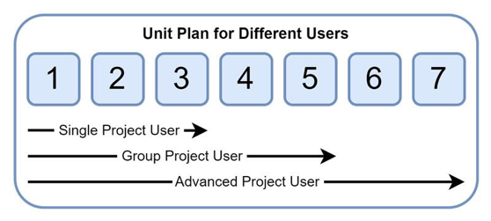
Pedagogical Aims
Aims to cater to different users’ requirements
Users do not need to complete the entire course (and are not expected to)
We suggest users pick the best option for them (they can always come back later)

Slide 5
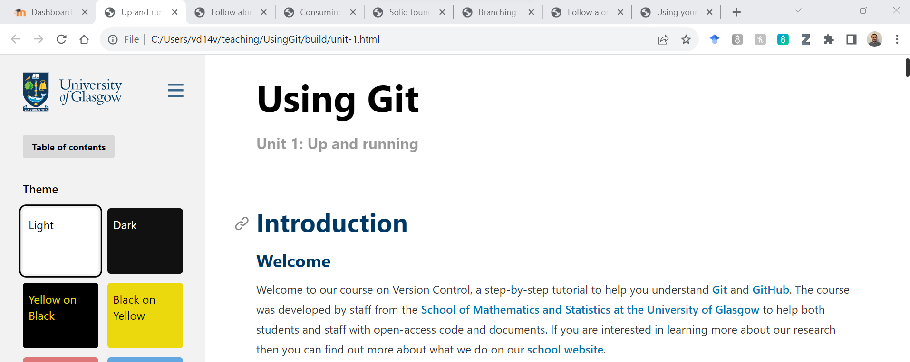
Course Availability
The course is available through Moodle and is used within courses in our school
You should have received a code already and have access to the page
Our notes our available as html files to incorporate additional accessibility features (Jack et al., 2023)
These slides are available at: https://github.com/vinnydavies/presentations
Jack et al. (2023). Reflections on designing and delivering an online distance learning programme in the mathematical sciences.

Slide 6
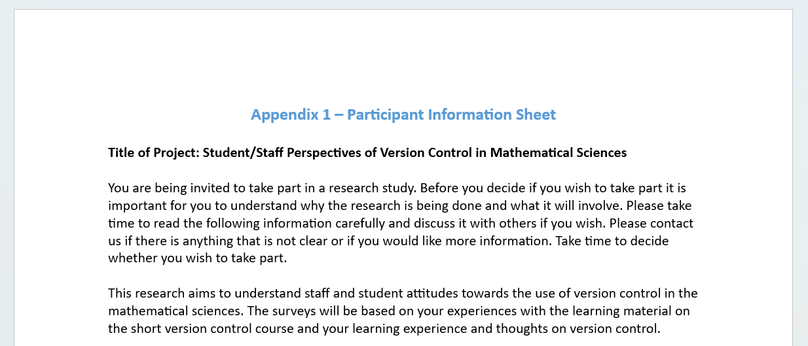
Course Feedback
We are collecting information to
Help improve the course
Describe our experiences to others

Slide 7

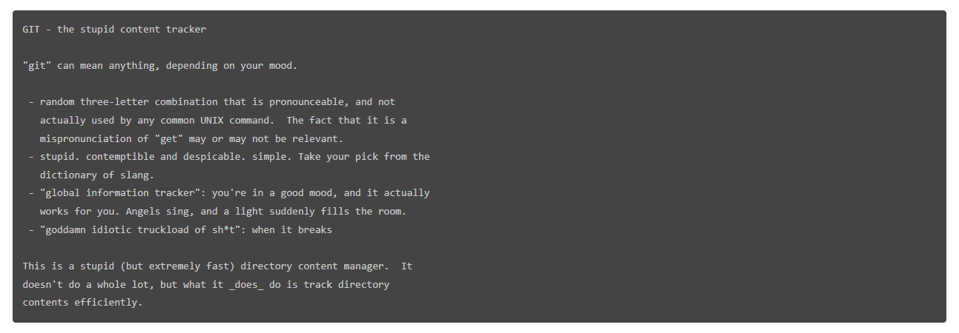
What is Git?
Git was invented by Linus Torvalds when he was no longer allowed to use BitKeeper for free
Torvalds first commit message was as follows:
With an entertaining README
Linus Torvalds
Creator of Linux & Git
(Image via Wikipedia)

Slide 8

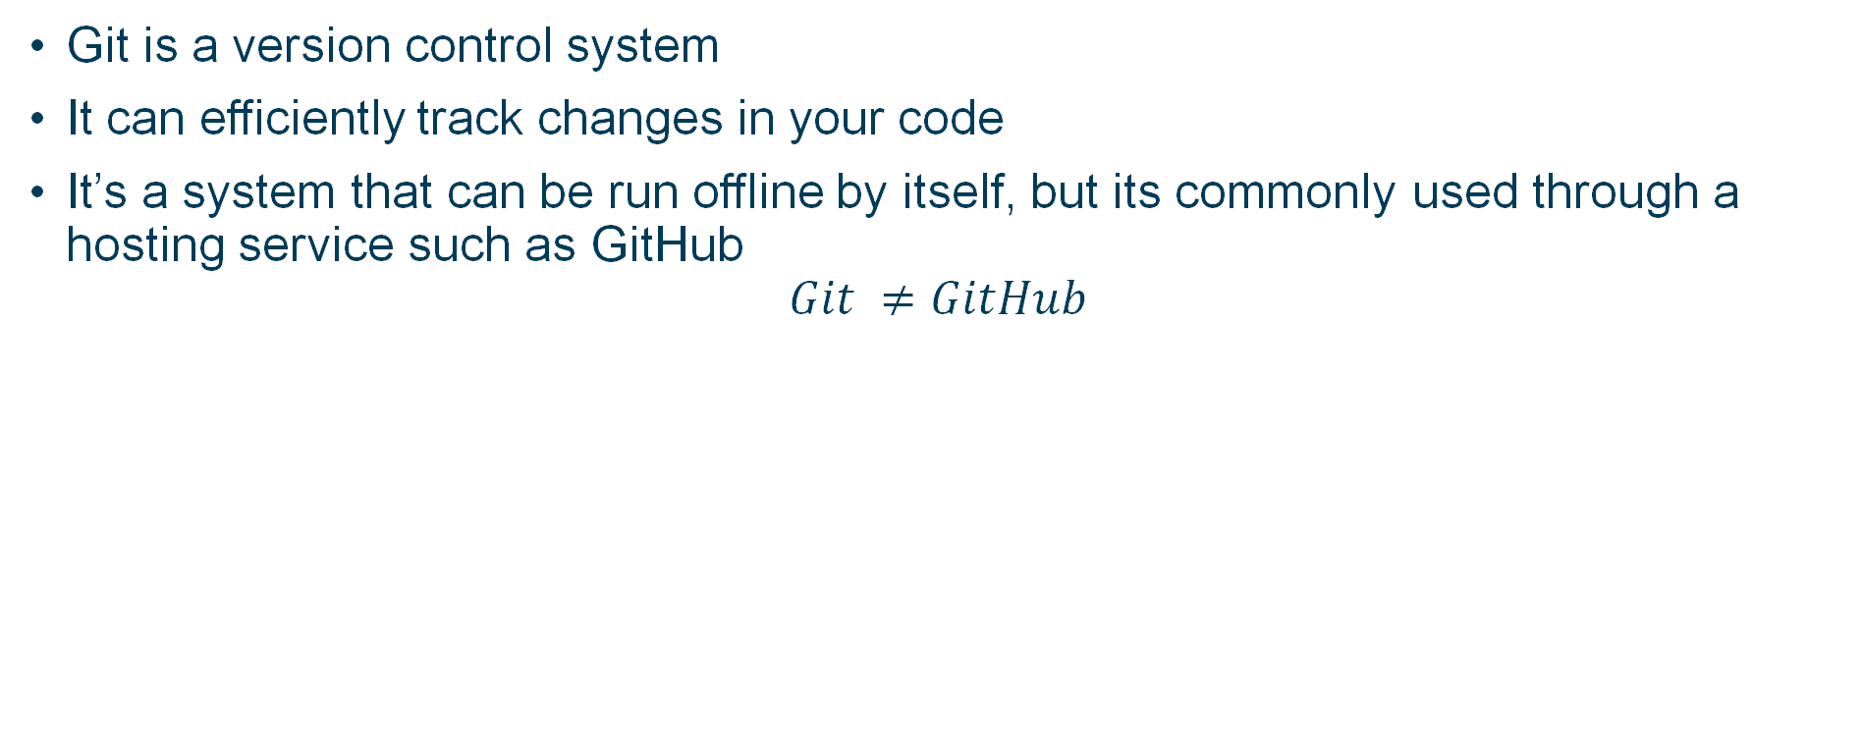
What is Git?
Git is a version control system
It can efficiently track changes in your code
It’s a system that can be run offline by itself, but its commonly used through a hosting service such as GitHub
$$Git ≠GitHub$$

Slide 9
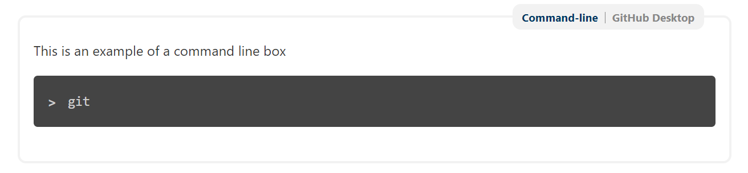
Installing Git
Git is primarily a developer tool, so it can be a little hard to install for some of us
Git is a command-line program, but you can install a graphical user interface (GUI) such as GitHub
For this presentation, we will focus on using Git through GitHub Desktop
Our course is designed for you to learn via either command-line or GitHub Desktop
Just click the tab in the notes!

Slide 10
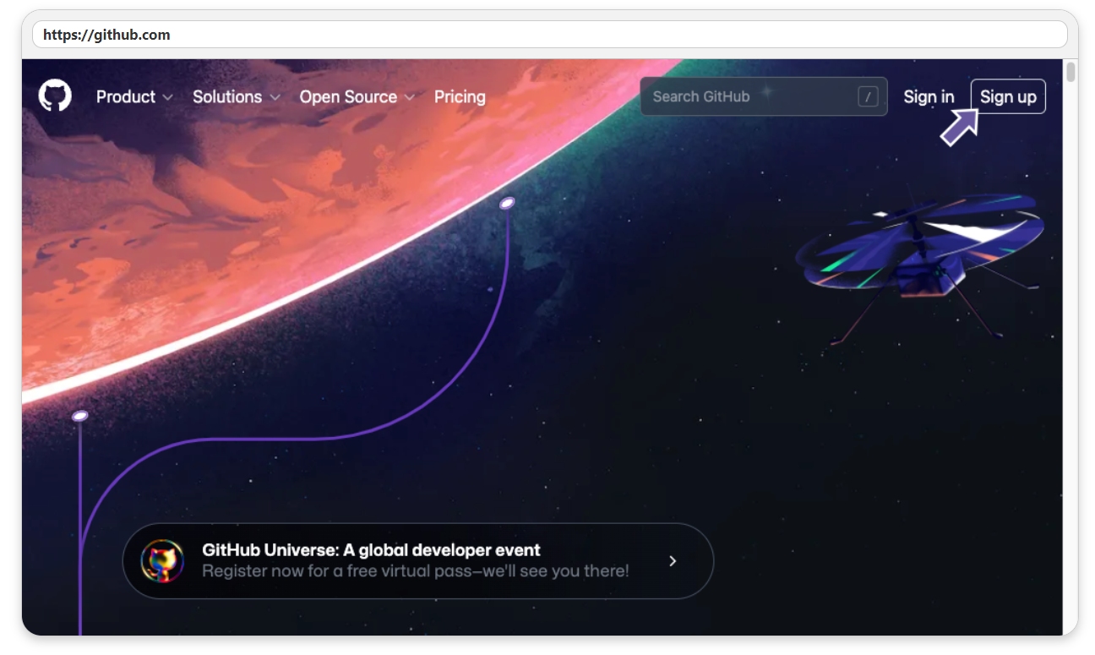
Sign up for GitHub
You can sign up for GitHub for free.
You can also download the desktop app for free.
There are other GUIs that you can use as well – Vinny uses Sourcetree, I use GitHub Desktop.

Slide 11
What is the point of Git/GitHub?
The primary reason for version control is to be able to track changes and if needed, go back to an older version.
It allows you to develop temporary and multiple versions of your code.
Imagine you want to test a new function…
Version control allows you to implement it and then only choose whether you integrate it with your main code once you are sure it works.
It can also allow you to have multiple versions
One user could be using your released code while another develops a version which temporarily stops it working

Slide 12
What is the point of Git/GitHub?
Using GitHub (or similar) allows you to effectively share your code with others
You can do this during or after completion
Others can then use your code and you can use other people’s code
How can you claim your method can be used to do X, Y, & Z if you don’t release it in a usable state?
You can’t!!!

Slide 13

What is the point of Git/GitHub?
Using GitHub (or similar) allows you to effectively share your code with others.
You can do this during or after completion.
Others can then use your code and you can use other people’s code.
How can you claim your method can be used to do X, Y, & Z if you don’t release it in a usable state?
You can’t!!!
Some (annoying?) reviewers will insist you share code if you make these statements
An example of a reviewer who will recommend REJECT if you make those statements and don’t share your code. Regardless of how good your paper is!

Slide 14
Creating a repository (repo)
There are two basic workflows for creating a repo and linking it to GitHub
Create a local repo and add (push) it to GitHub (Using Git, Unit 2)
Create a repo on GitHub and cloning it (Using Git, Unit 3)
We are going to start with the first option, as the second option can be used for other people’s projects as well.

Slide 15
Creating a repository (repo)
There are two basic workflows for creating a repo and linking it to GitHub
Create a local repo and add (push) it to GitHub (Using Git, Unit 2)
Create a repo on GitHub and cloning it (Using Git, Unit 3)
We are going to start with the first option, as the second option can be used for other people’s projects as well.
Create a local repo
Create a file (and ‘stage’ it)
‘Commit’ the file
Publish the repo on GitHub

Slide 16
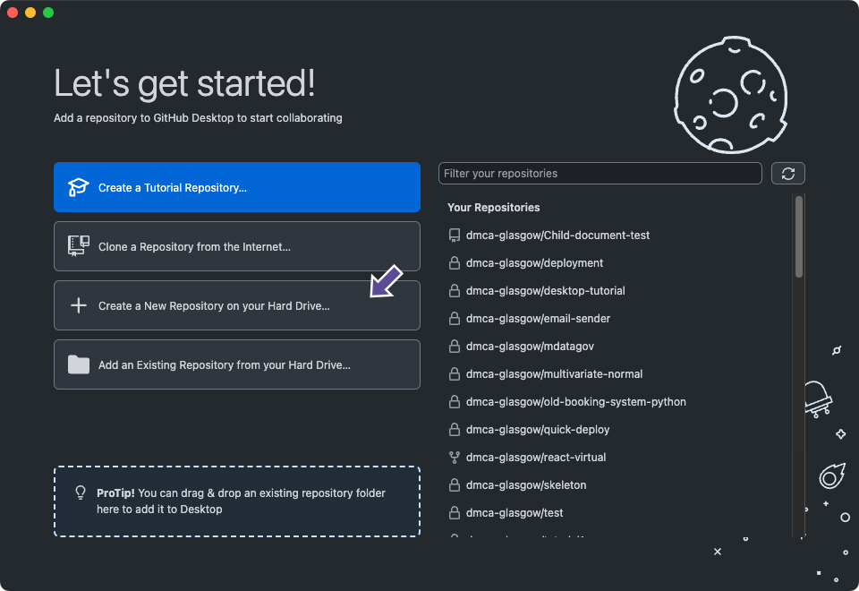
Creating a local Git repo

Slide 17
Creating a local Git repo
At this point you have not committed anything to Git (or GitHub)

Slide 18
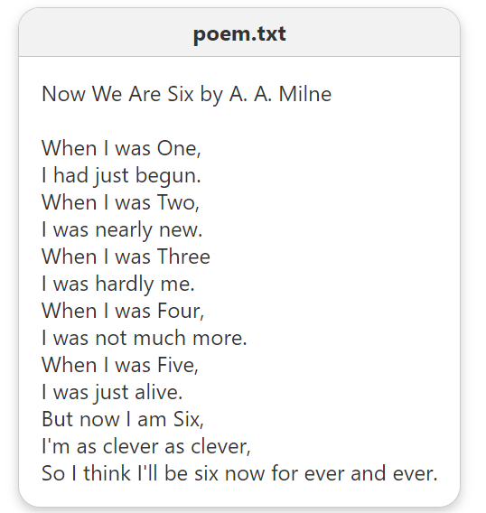
Creating a local Git repo
We can now create a file to go into the repo
This file might be your R or Python code
At this point you have not committed anything to Git (or GitHub)

Slide 19
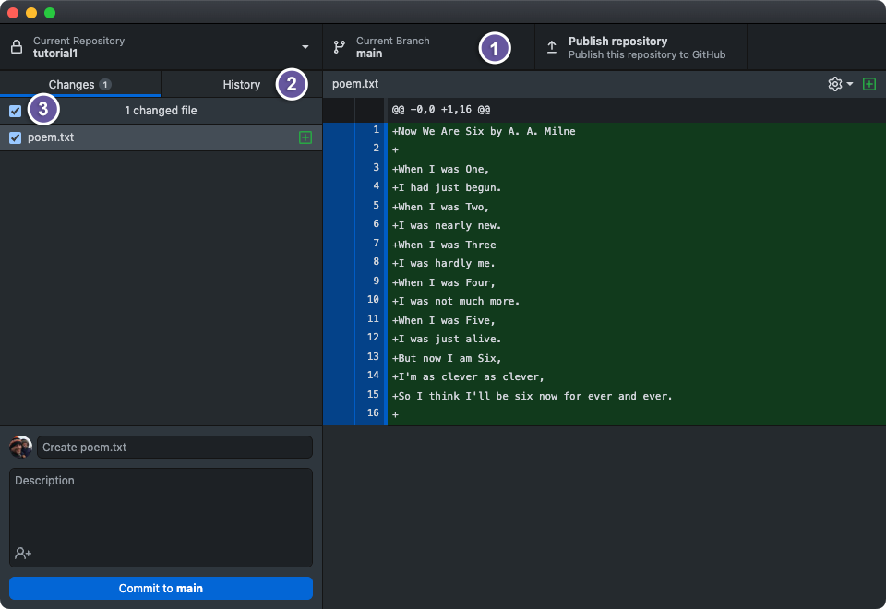
Creating a local Git repo – Git status
You will now be able to see detected changes to your files

Slide 20
Creating a local Git repo – Git status
You will now be able to see detected changes to your files
Here you can see we are on the ‘main’ branch (more about branching soon)

Slide 21
Creating a local Git repo – Git status
You will now be able to see detected changes to your files
This is the history tab; you can see all your old commits here (there are none currently)

Slide 22
Creating a local Git repo – Git status
You will now be able to see detected changes to your files
The tick here means that the file has been ‘staged’ and is ready to be part of your next commit

Slide 23
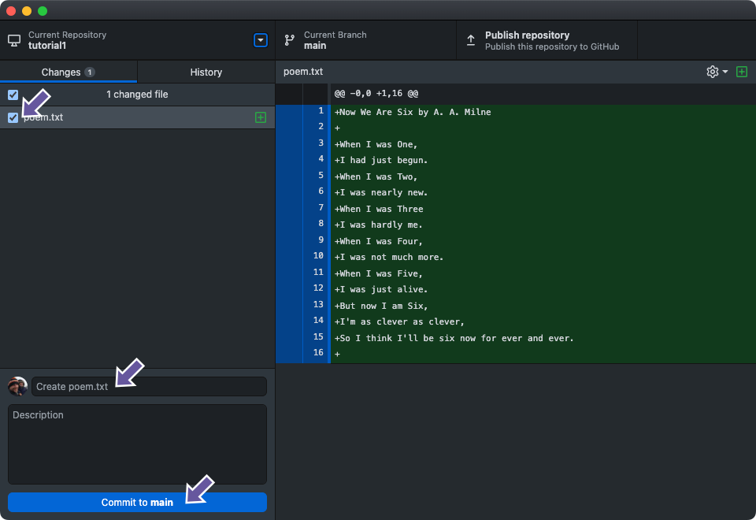
Creating a local Git repo – Commit
We now want to ‘commit’ the file. This can be thought of as creating a version of your files, essentially a snapshot in time. It's still NOT on GitHub though!

Slide 24
Creating a local Git repo – Commit
We now want to ‘commit’ the file. This can be thought of as creating a version of your files, essentially a snapshot in time. It's still NOT on GitHub though!
Make sure your file is staged. Later we may have multiple files here.

Slide 25
Creating a local Git repo – Commit
We now want to ‘commit’ the file. This can be thought of as creating a version of your files, essentially a snapshot in time. It's still NOT on GitHub though!
Add a commit message describing the changes you have made

Slide 26
Creating a local Git repo – Commit
We now want to ‘commit’ the file. This can be thought of as creating a version of your files, essentially a snapshot in time. It's still NOT on GitHub though!
Press commit to create the new version of your files

Slide 27

Gitgraphs – A small aside
To help with understanding branching later on, we are going to use Gitgraphs
While its not very helpful now, this is the Gitgraph we now have

Slide 28
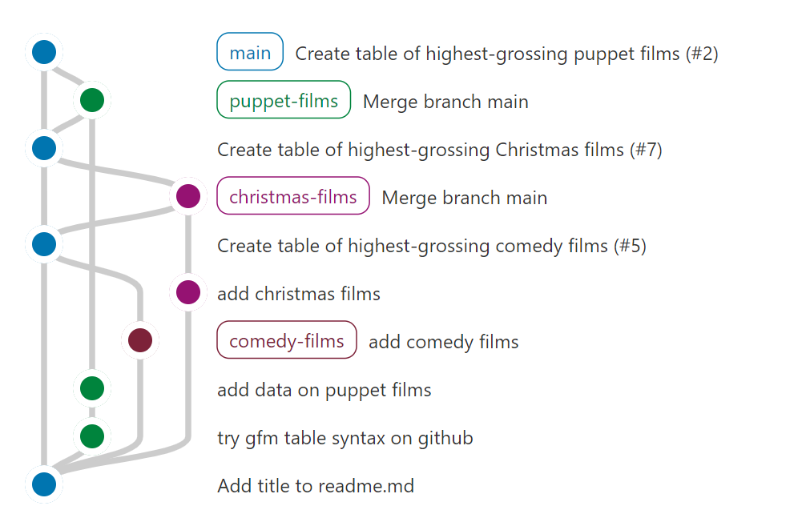
Gitgraphs – A small aside
To help with understanding branching later on, we are going to use Gitgraphs
While its not very helpful now, this is the Gitgraph we now have
We will eventually end up with involved ones like this:

Slide 29
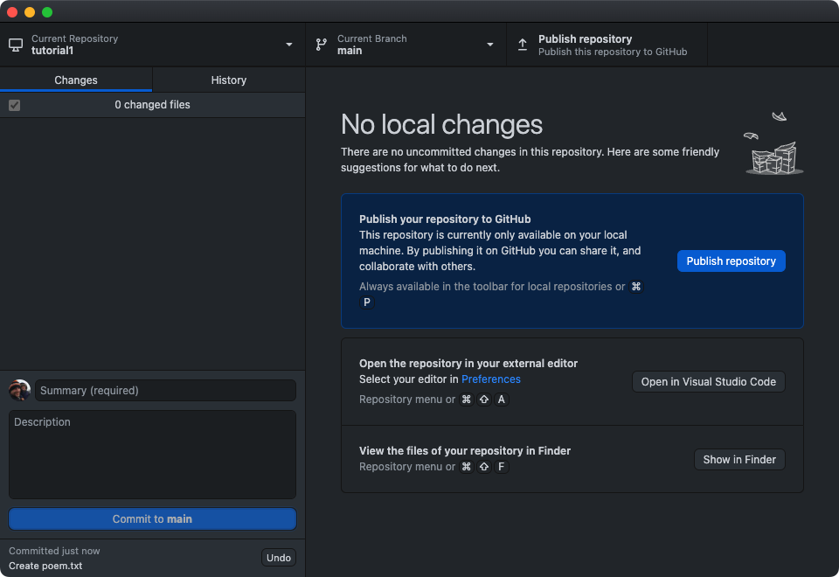
Creating a local Git repo – Post Commit
Now we have committed, we will see that we no longer have any local changes

Slide 30
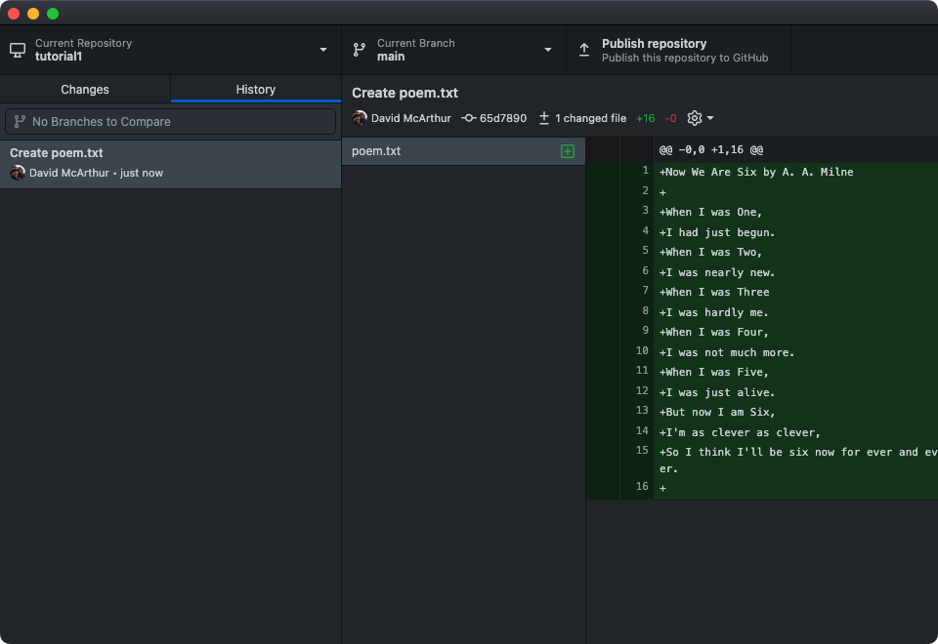
Creating a local Git repo – Post Commit
And our commit sits nicely in our history tab.
We still do not have it on GitHub though!

Slide 31
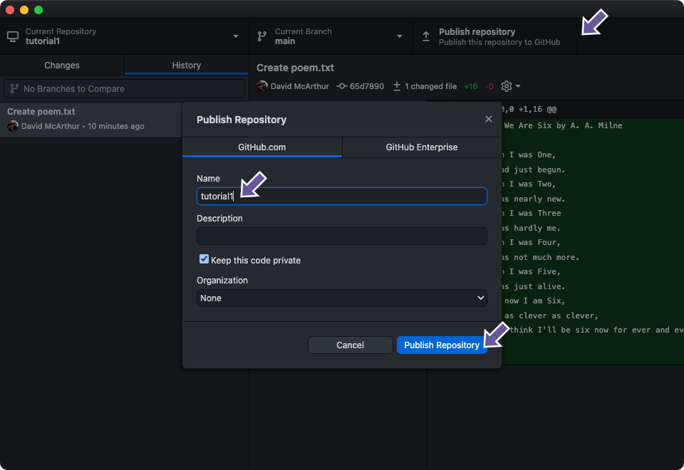
Creating a new repo on GitHub
We can now publish our repo directly from GitHub Deskop

Slide 32
Creating a new repo on GitHub
We can now publish our repo directly from GitHub Desktop
Click here to start the publishing process – Just make sure you are allowed to share everything in your repo!

Slide 33
Creating a new repo on GitHub
We can now publish our repo directly from GitHub Desktop
Choose a suitable name

Slide 34
Creating a new repo on GitHub
We can now publish our repo directly from GitHub Desktop
Choose whether to keep it private or make it public. If you start private, then you can make it public later

Slide 35
Creating a new repo on GitHub
We can now publish our repo directly from GitHub Desktop
Publish your repo

Slide 36
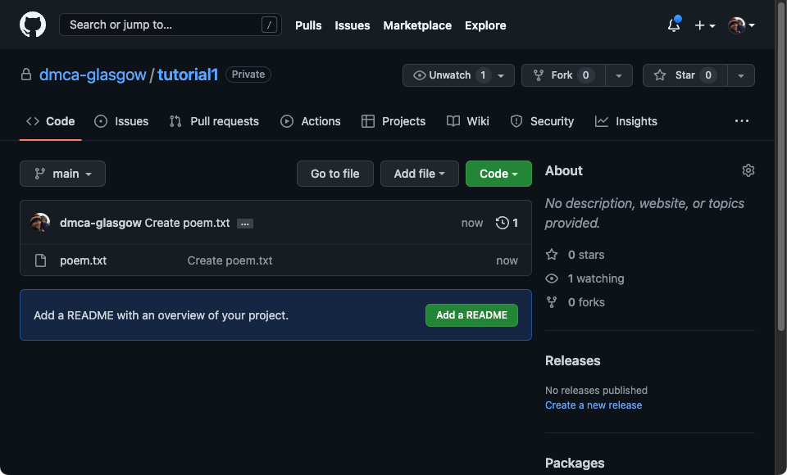
Creating a new repo on GitHub
And you should now be able to see it on GitHub

Slide 37
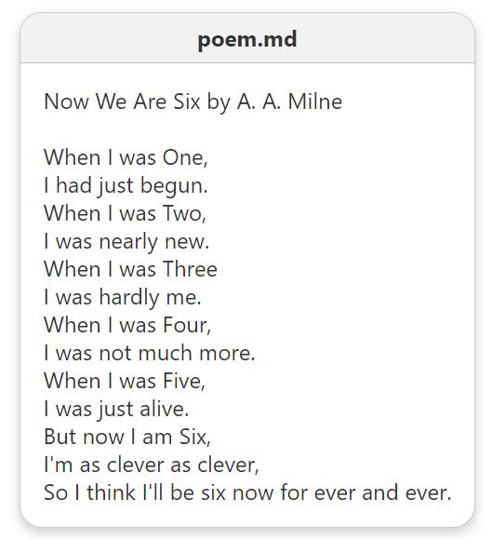
Updating your repo
From a Git perspective updating a file is essentially the same process
If you aren’t from a computing background, it might feel a bit different though
Let’s rename our file from poem.txt to poem.md

Slide 38
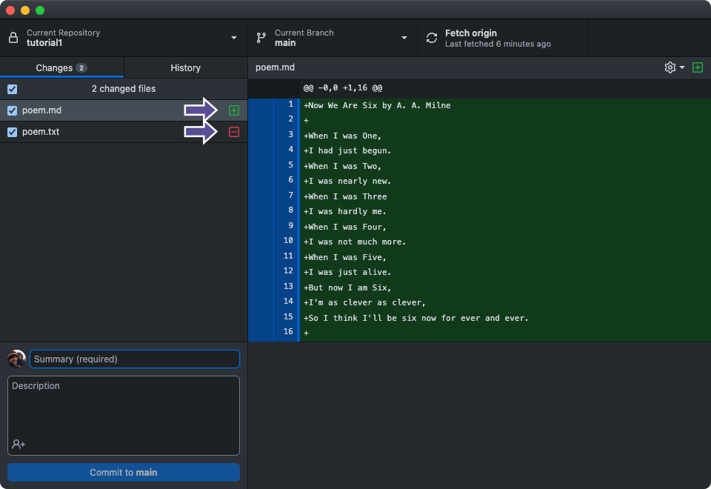
Updating your repo
From a Git perspective this is equivalent to deleting and creating a new file

Slide 39
Updating your repo
From a Git perspective this is equivalent to deleting and creating a new file
Adding and deleting the files

Slide 40
Updating your repo
From a Git perspective this is equivalent to deleting and creating a new file
Green as we are adding the file.
We would see all red if we were on poem.txt

Slide 41
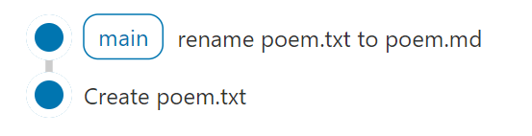

Updating your repo
We can then ‘commit’ as we did before, and we get an updated Gitgraph:
Note that this is only committed to Git locally, the change will not be reflected on GitHub, which will still have the following Gitgraph:
We will discuss how to update GitHub in a minute

Slide 42
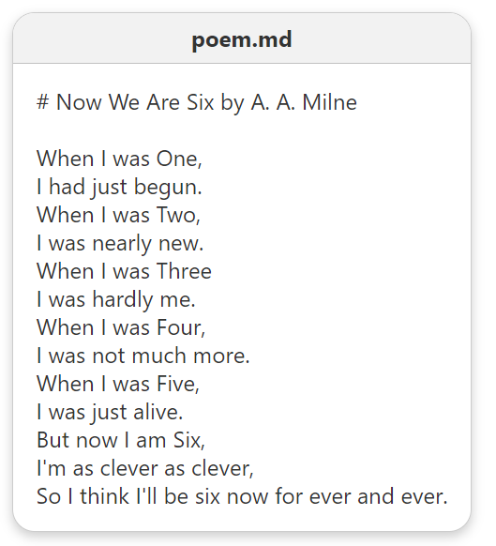
Updating your repo
Let’s first give our file a proper title using Markdown format
Add the # to make a section title.

Slide 43
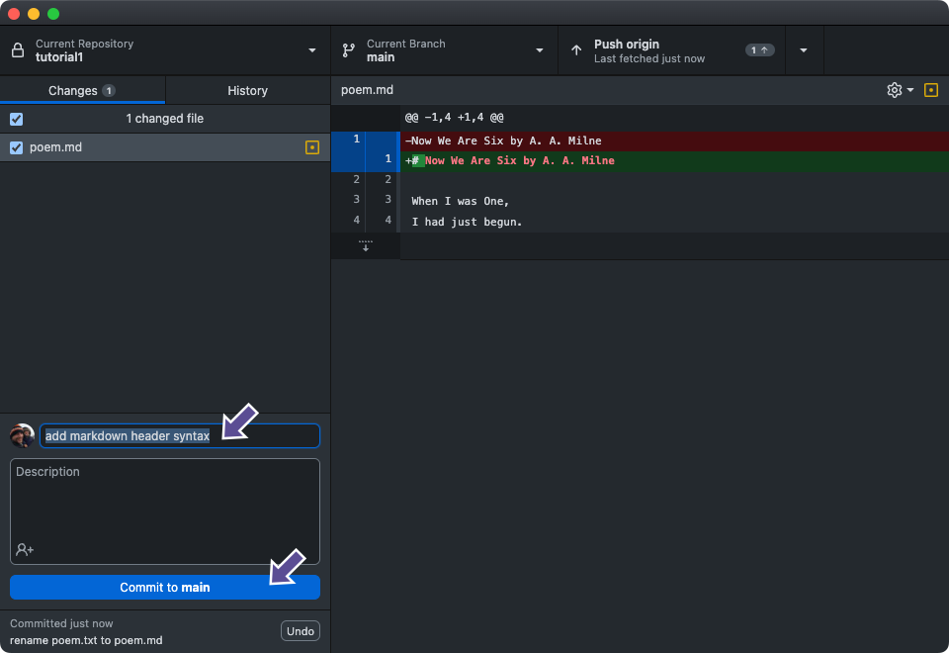
Updating your repo
This time we see changes to the text rather than the files
We can then give it a commit message and ‘commit’ again

Slide 44
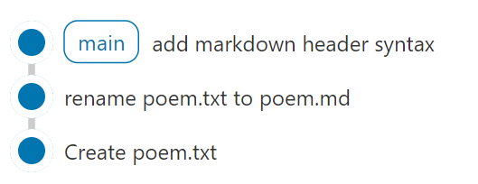
Updating your repo
We have an updated local Gitgraph:
But our GitHub Gitgraph remains the same
Let’s fix this now!

Slide 45
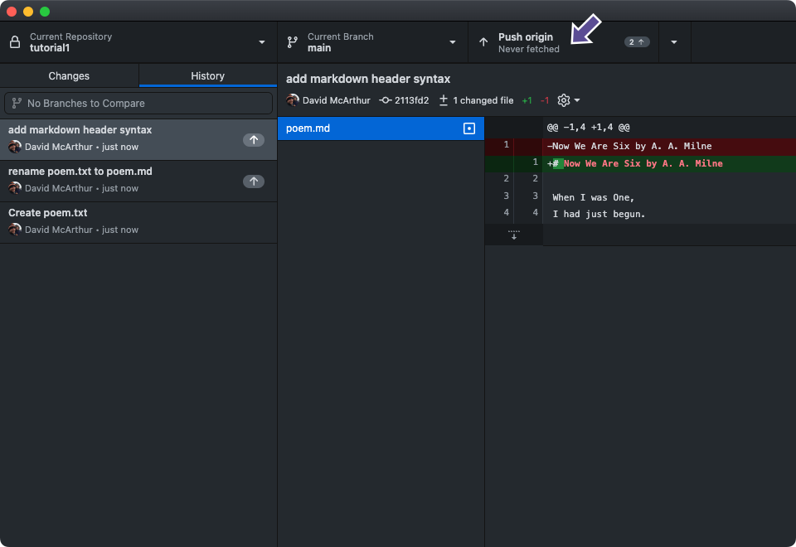
Updating your repo
To synchronise both repos, we need to ‘push’ our local changes

Slide 46
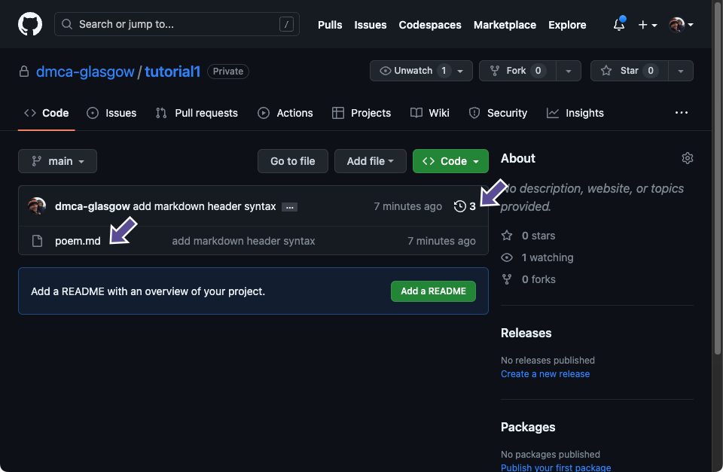
Repo created and updated successfully!
We have updated our GitHub repo and you can see the changes below

Slide 47
Repo created and updated successfully!
We have updated our GitHub repo and you can see the changes below
3 – The number of commits we have done

Slide 48
Repo created and updated successfully!
We have updated our GitHub repo and you can see the changes below
Our updated file

Slide 49
Repo created and updated successfully!
We have updated our GitHub repo, and you can see the changes below
The commit message for the last change to this file

Slide 50
Special Conventions
.gitignore
A list of files that we don’t want to commit to our repo. Can edit this in Github Desktop under ‘Repository Settings…’
README
Essentially the homepage of your repo. Can display download, usages, and citation information
LICENSE
Tells people how they are allowed to use your files. People don’t always follow it though!

Slide 51
Using Open-Source Projects
Sharing code so others can use it, goes hand-in-hand with using other people’s code
The README and License help you to understand how to do that

Slide 52
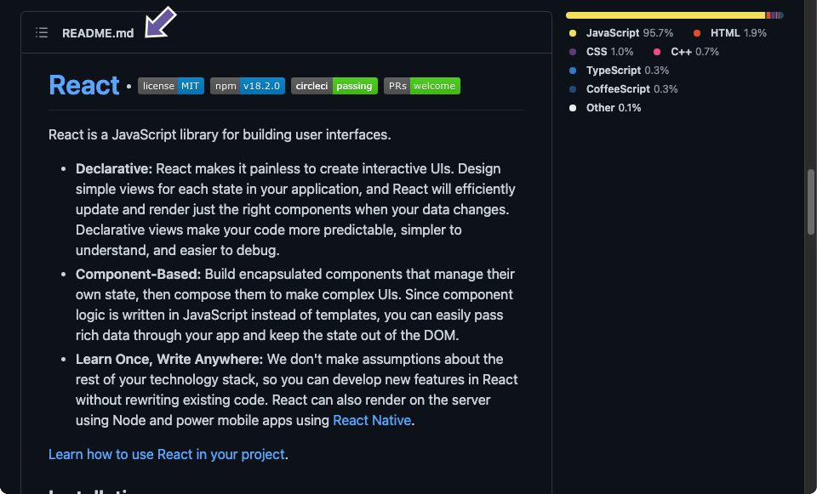
Using Open-Source Projects
The README.md file (generally capitalised to be more prominent) can give you a lot of information about the project
This can sometimes even be split into sections in Wikis etc

Slide 53
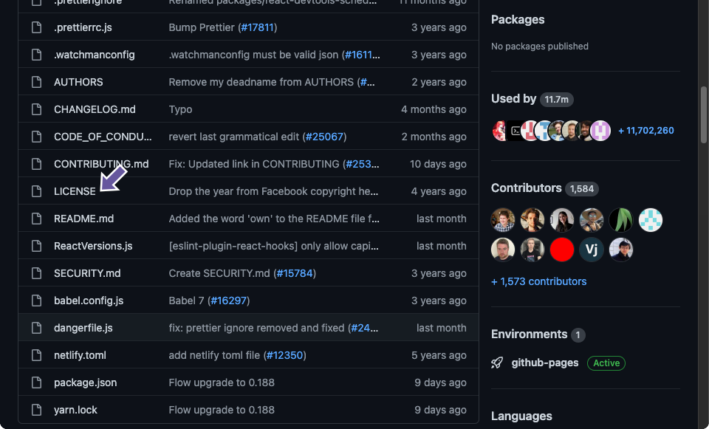
Using Open-Source Projects
The LICENSE file tells you how you can use files
You can (and should) also add one to your own repo
Our course has information (and links) as to how to choose one

Slide 54
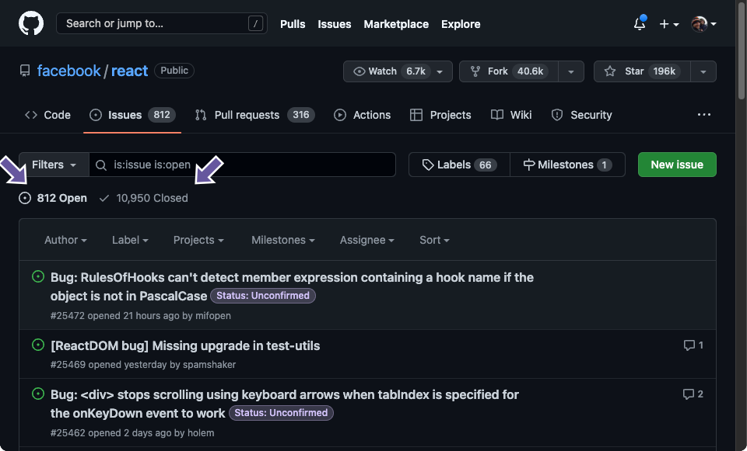
Using Open-Source Projects
Issues provide a way of keeping track of changes people want to make to a repo
You can add issues to your own repo or someone else's
Issues can include bug fixes, improvements and beyond

Slide 55
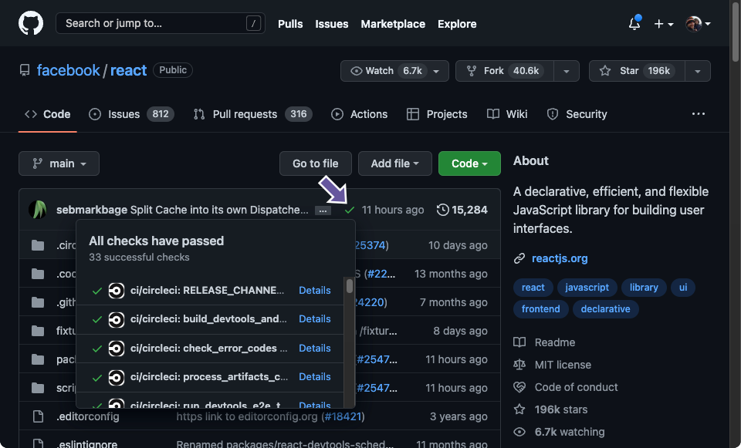
Using Open-Source Projects
Tests / Continuous Integration provide a way of automatically testing code changes
For this project we had a spell checker, but you can write your own project specific tests

Slide 56
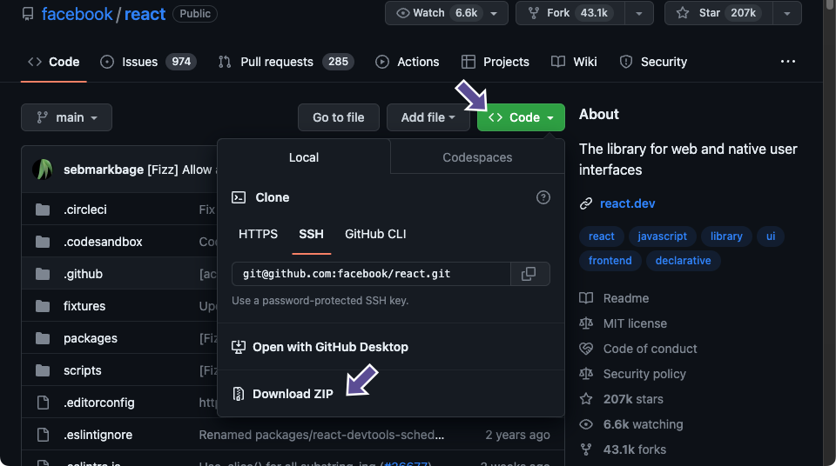
Downloading a project
The easiest way of using someone else’s code is to just download it
It's important to note that you are just downloading the codebase
This means that you will lose Git functionality, e.g. you won’t get updates when they are made

Slide 57
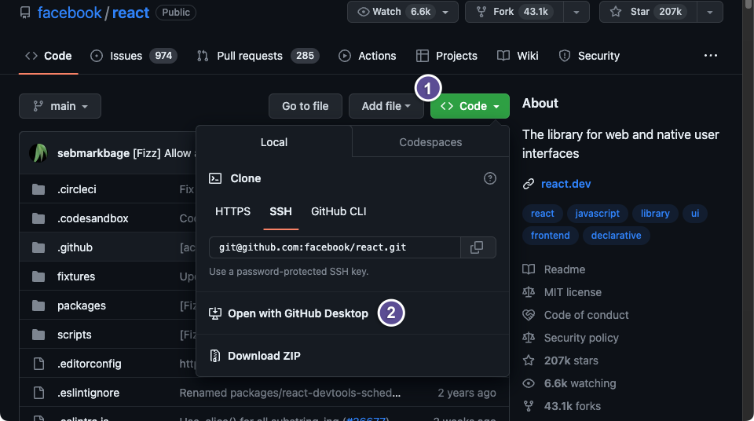
Cloning a project
Cloning a project keeps all the nice Git stuff
This allows you to get updates and potentially make changes to the main repo yourself

Slide 58
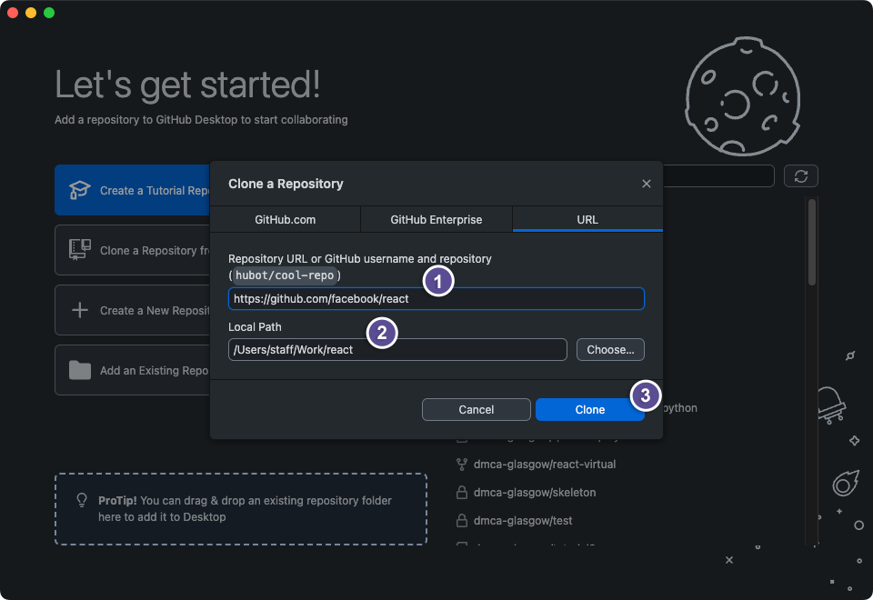
Cloning a project
To do this you need to the URL of the repo you are trying to clone, and a location you want to put the cloned folder

Slide 59
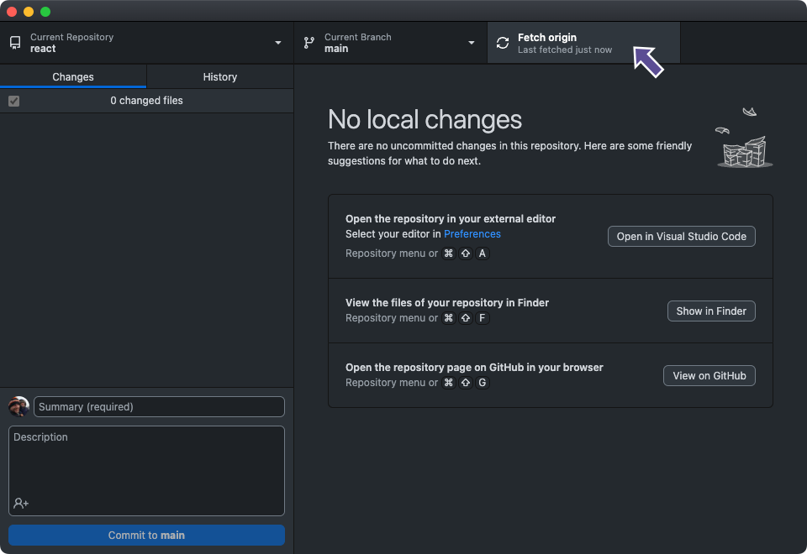
Cloning a project
If an update is made, then all you need to do is resynchronise your local repo with the GitHub version

Slide 60
Forking a project
While you can clone your own projects and some other people’s projects. Not all repos will allow you to do this
Examples of this would be large projects, e.g. TensorFlow, React
You can however fork them
Forking essentially allows you to create a copy of the repo on your own GitHub profile – crucially, this include the Git metadata
Unlike cloning, you then have editing privileges
As you have the metadata, you can still merge your project back to the original – if the owner of the original repo lets you

Slide 61
Creating a Pull Request (PR) to an existing project
We are going to demonstrate a PR or Forked PR in the context of contributing to a different repository.
To do this you will need to take the following steps:
Fork the project on GitHub to your account
Clone it to your local machine
Make the change
Stage, commit and push the change to GitHub
Create a Pull Request on the original project which points to your forked repository
Code review: the project maintainer will review your change to decide if they want to integrate it, close it, or request modifications

Slide 62
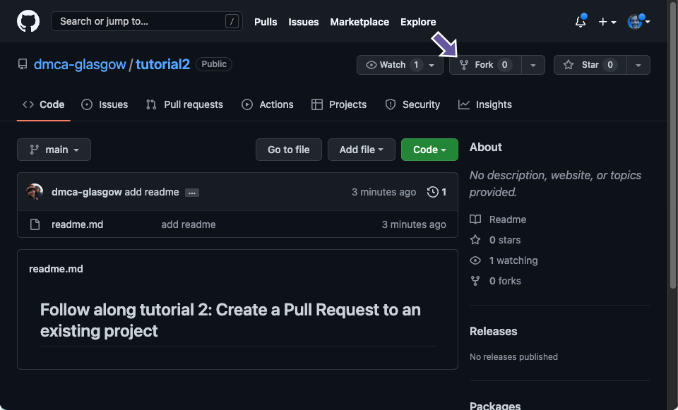
Forking a repo
Here we have identified a repo we want to work
We then click the Fork button at the top

Slide 63
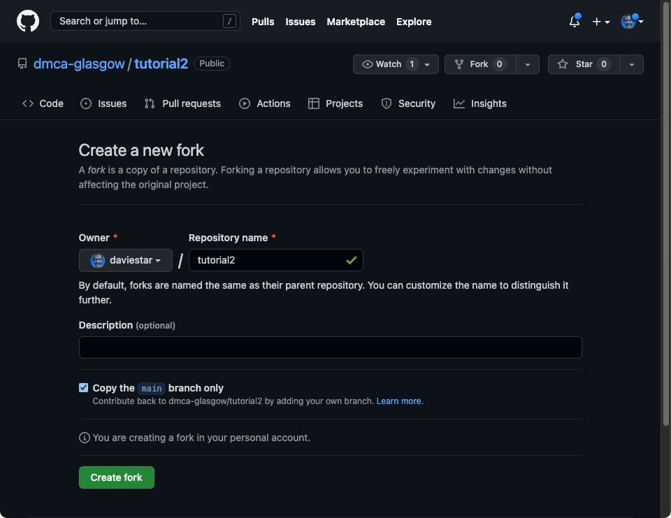
Forking a repo
You can give it a new name and description if you want, and choose which branches to fork

Slide 64
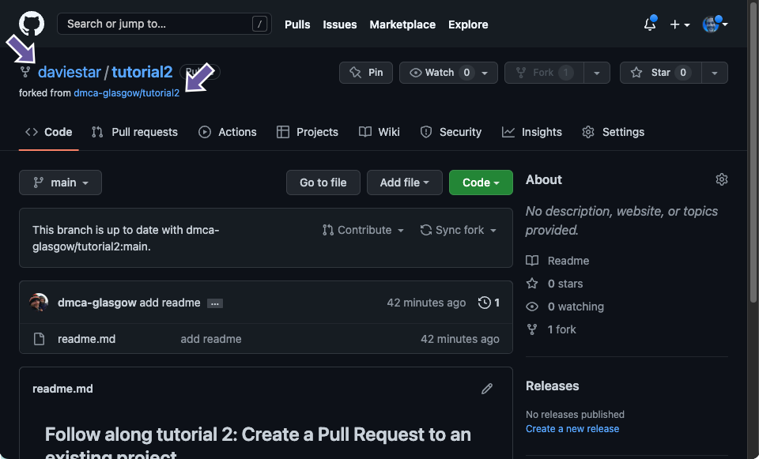
Forking a repo
You will now have a new repo and you can see from which repo it forked from

Slide 65
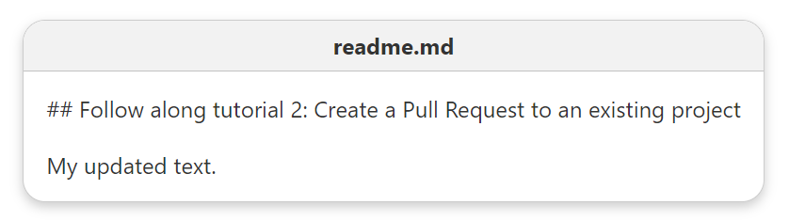
Cloning and making a change
You now need to clone the repo as you did before
And we can make some changes which we want to commit back to the original repo

Slide 66
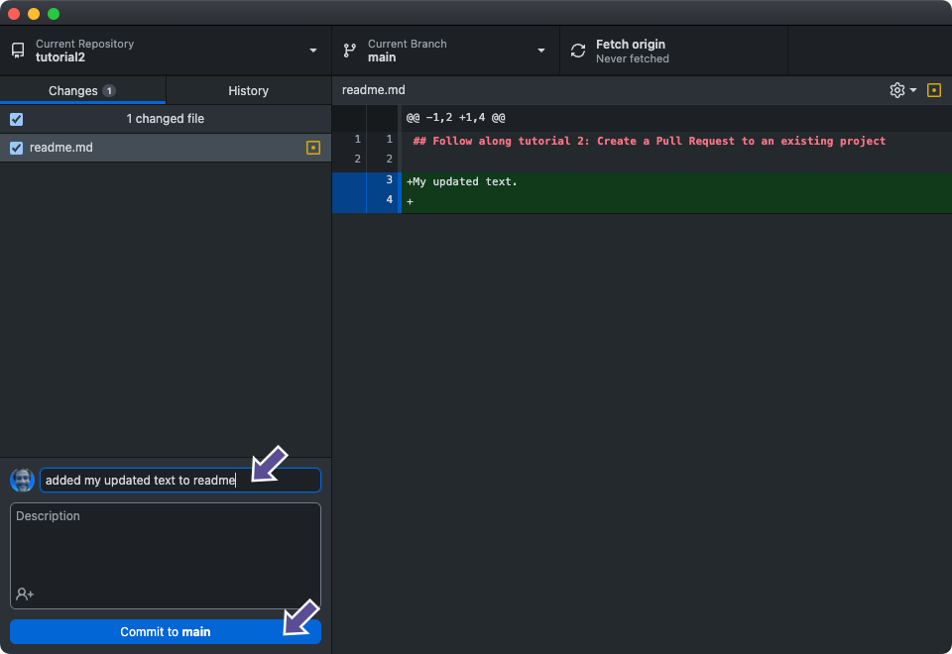
Cloning and making a change
We can then commit the changes with a nice commit message

Slide 67
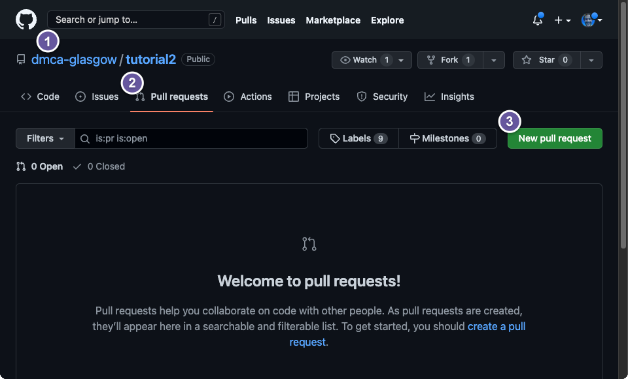
Create a (Forked) PR
We can then create our (Forked) PR and request to have our changes merged into the original repo

Slide 68
Create a (Forked) PR
We can then create our (Forked) PR and request to have our changes merged into the original repo
Navigate to the original project repo

Slide 69
Create a (Forked) PR
We can then create our (Forked) PR and request to have our changes merged into the original repo
Click on the Pull Requests tab

Slide 70
Create a (Forked) PR
We can then create our (Forked) PR and request to have our changes merged into the original repo
Click on the green button with the label “New pull request”

Slide 71
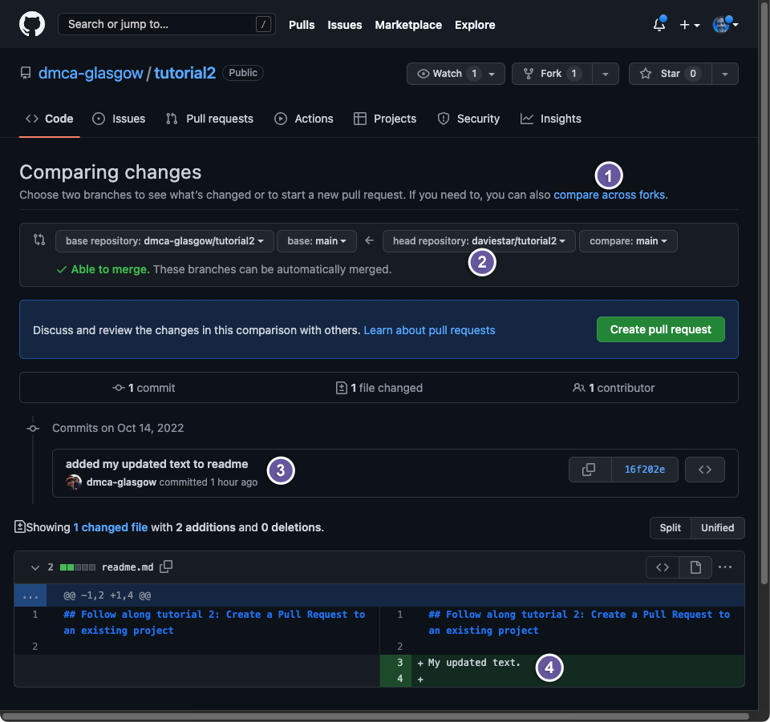
Create a (Forked) PR

Slide 72
Create a (Forked) PR
Click "compare across forks"

Slide 73
Create a (Forked) PR
Select your repository from the "head" dropdown menu

Slide 74
Create a (Forked) PR
See your commit message!

Slide 75
Create a (Forked) PR
See the contents of your commit!

Slide 76
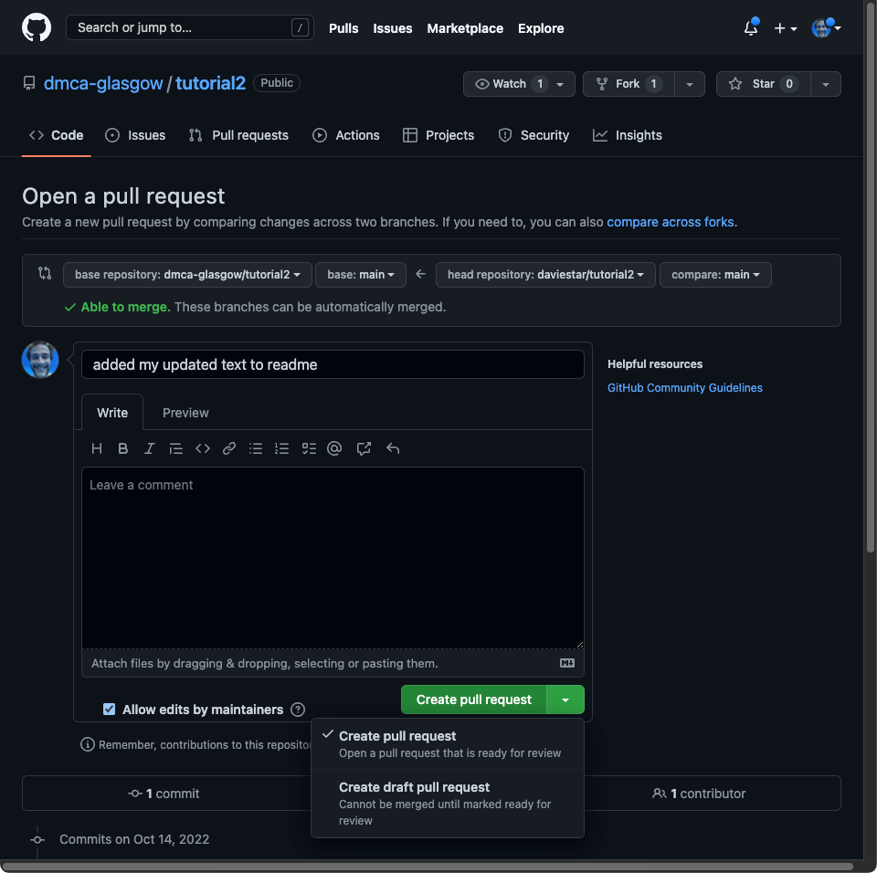
Create a (Forked) PR
You can then rename your PR
And create your PR

Slide 77
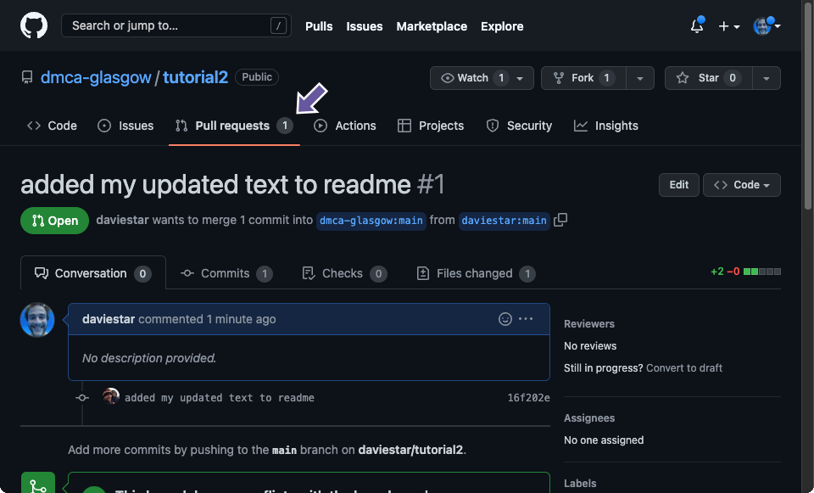
Create a (Forked) PR
It's now down to the original repo’s owner to review your request and decide if they want to merge it. They might even ask you to make changes.

Slide 78
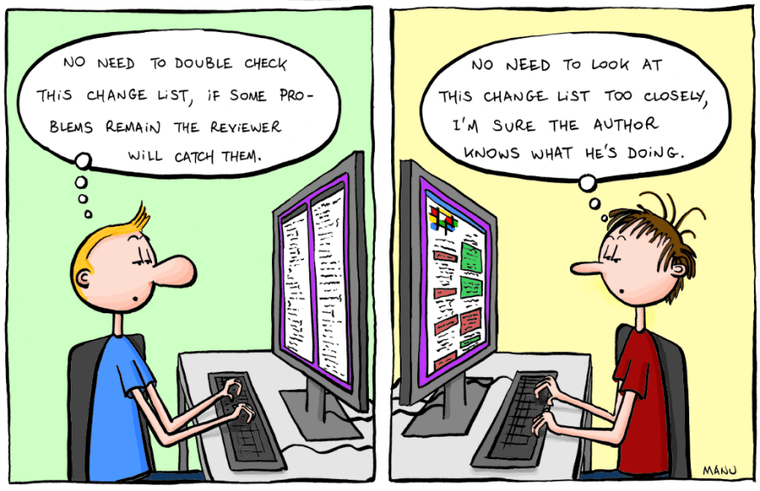
How not to do a code review
Mann Cartoons

Slide 79
Code review
PRs are a great time to do code review, especially for your own PRs
When doing PRs on your own repos it also gives your colleagues a chance to review your code and suggest changes.
We used this extensively for creating this course
Before we get to another example, it's worth touching on some other useful practises that you might find useful
These can be useful for solo and group projects

Slide 80
Commit Messages
Commit messages are an important part of Git
When writing them it can seem somewhat overkill, but you also don’t want to come back to this:

Slide 81
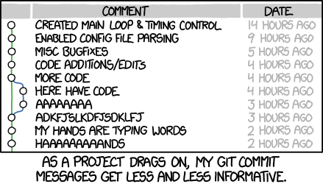
Commit Messages
Commit messages are an important part of Git
When writing them it can seem somewhat overkill, but you also don’t want to come back to this:
XKCD 1296: Git commit

Slide 82
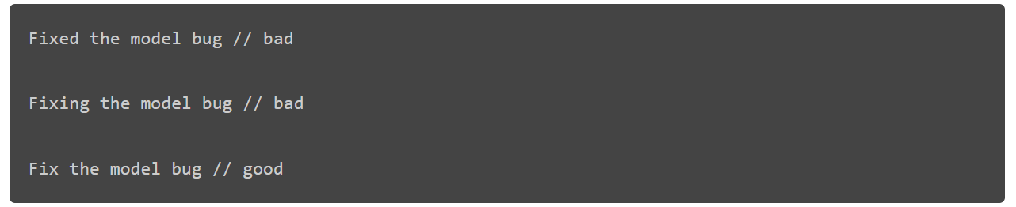
Commit Messages
There are lots of good ways to write commits
Some groups even agree commit strategies
We just suggest you spend an extra couple of seconds to make them slightly clearer
Another good rule of thumb is to prepend it with “If applied, this commit will…”

Slide 83
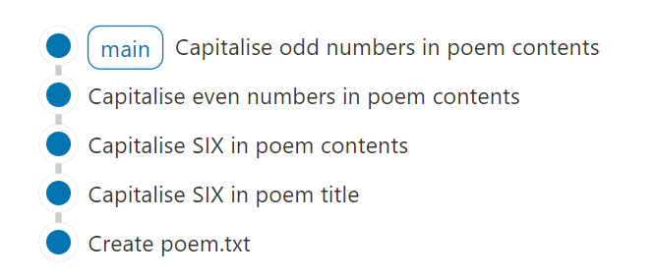
Committing regularly
Committing regularly is also extremely beneficial
Its helps break down your changes into sensible parts and identify problems more easily
It makes writing sensible commit messages easier
We can more easily undo our changes if we ever need to

Slide 84
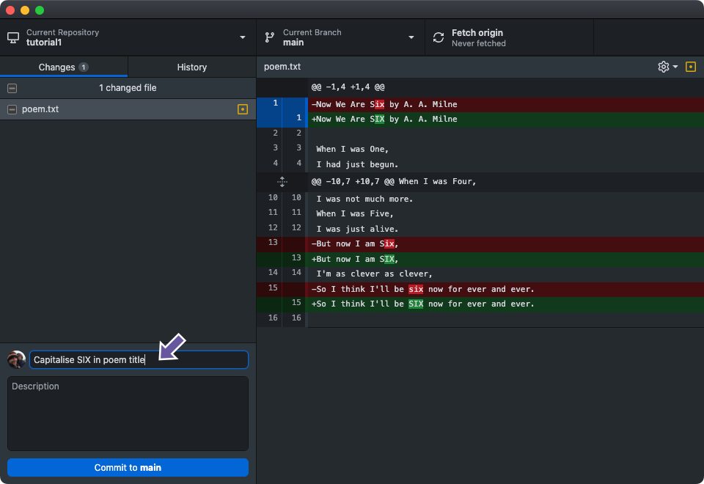
Hunks
One way that Git helps us do this is through ‘Hunks’
If we just select certain parts or hunks, then we can break problems down into bits
We can select our hunks and then just stage and commit those changes

Slide 85
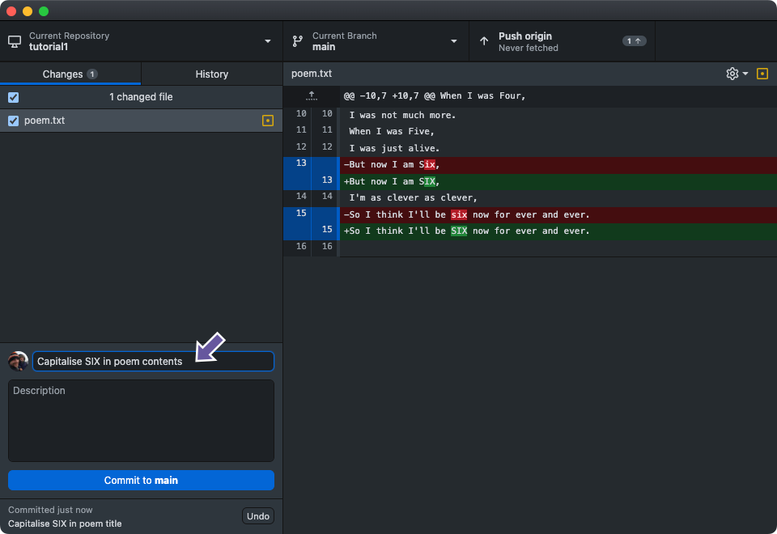
Hunks
One way that Git helps us do this is through ‘Hunks’
If we just select certain parts or hunks, then we can break problems down into bits
We can stage and commit the rest of our hunks in a separate commit with a different commit message

Slide 86

Branching
Up until this point we have been quite detailed about how to do things
The content covering branching is going to be a little less hands on and will just aim to give you an idea of what you can do, and why it might be useful
You can find detailed examples in our course
Milica’s Blog

Slide 87
Branching Strategies
There are lots of different approaches to how to do branching

Slide 88
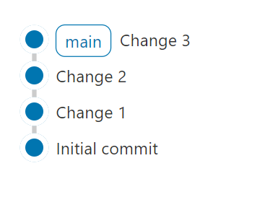
Branching Strategies
There are lots of different approaches to how to do branching
The most obvious one, which is generally fine for single user projects, is called “mainline integration”

Slide 89
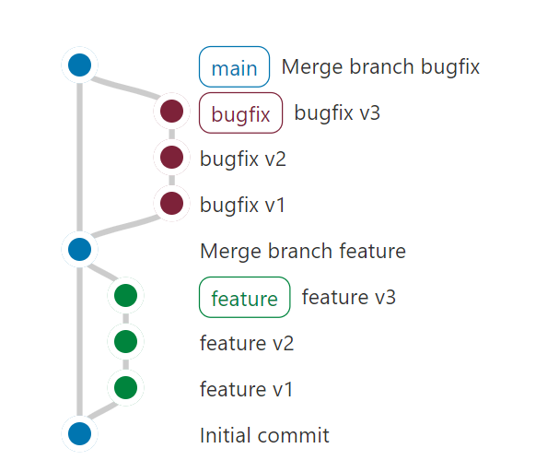
Branching Strategies
A potentially better one is the GitHub Flow strategy
Although a hybrid between the two sometimes becomes the case

Slide 90
Branching Strategies
We use GitHub Flow to allow multiple people work on our project simultaneously
We also used it so we could keep working on new things while someone else found time to review
Example
Vinny drafts Unit 2 and asks Craig for a review
Craig is busy, Vinny wants to carry on working
Vinny opens another branch and begins working on Unit 3
Craig reviews Unit 2 and Vinny switches back and merges the unit 2 branch (usually the drafter is the one who approves the merge)
The draft Unit 3 features do not get merged without yet being reviewed. Vinny can go back to working on them

Slide 91
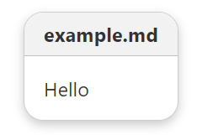

Branching
Let’s start a (relatively) simple example by creating a new repo
We begin with a single commit with the following content
We get the following Gitgraph

Slide 92
Branching
We then decide we want to add an explanation mark, so we create a new branch to make the change – Yes, this is complete and utter overkill for this example
You do this be going to the main menu and selecting Branch > New Branch

Slide 93

Branching
We then decide we want to add an explanation mark, so we create a new branch to make the change – Yes, this is complete and utter overkill for this example

Slide 94


Branching
We then make our changes and commit

Slide 95

Branching
We then make our changes and commit
Giving us our updated Gitgraph

Slide 96
Branching
We then make our changes and commit
Giving us our updated Gitgraph
Note we now have a new branch

Slide 97


Branching
Now we have made our change, we want to merge it back into the branch.
To do that we need to switch back to

Slide 98

Branching
We then need to start the ‘merge’

Slide 99

Branching
And choose the branch that we want to merge back in

Slide 100

Branching
The rejoining of the branches themselves then becomes a commit on the branch, as this is the one we are updating
In our Gitgraph, we that by the lines link the two branches, but the update is vertically aligned with our ‘main’ branch

Slide 101

Branching
After checking we have successfully merged, its then good to delete the old branch

Slide 102


Branching
A slightly more complex situation occurs when we try to make change to two branches and then merge
Let’s create a new branch converting the ! to a ?

Slide 103


Branching
Say we then updating the file on and get the following
Switching back to then causes problems if you don’t commit your changes first
GitHub Desktop allows us to automate stashing in various formats at this point

Slide 104

Branching
The notes show you how to do this properly, but let’s assume you have instead make the changes on instead
We end up with the following Gitgraph:
At this point we have two different heads with two different versions of our file
Crucially though, they don’t conflict with each other as different lines have changed

Slide 105

Branching
With no conflicts, merging is as straightforward as it was before
Git can work out how to combine the two based on the differences and their history
We end up back with one branch and delete the other

Slide 106



Branching & Merge Conflicts
A more complex situation arises if our two versions disagree
Let’s create a new branch called and change the file to the following
Giving the following Gitgraph

Slide 107


Branching & Merge Conflicts
If we then make the following change on we end up with a problem
At this point, we have the following Gitgraph

Slide 108
Branching & Merge Conflicts
At this point we have the following:

Slide 109

Branching & Merge Conflicts
At this point we have the following:
What goes here!?!?!?

Slide 110

Branching & Merge Conflicts
At this point we have the following:
What goes here!?!?!?

Slide 111
Branching & Merge Conflicts
At this point Git doesn’t know what to do and passes back to us to decide
There are two approaches to deciding / fixing the problem

Slide 112

Branching & Merge Conflicts
We can choose to press ahead with the merge, like we did before

Slide 113

Branching & Merge Conflicts
GitHub Desktop will alert you to this and open the files in your code editor

Slide 114

Branching & Merge Conflicts
Where you will see something like this
There is no automatic way of fixing this, so you will have to change it manually deleting the merge conflict syntax

Slide 115


Branching & Merge Conflicts
In this case, we will blend them together as follows
Then merging them back together gives us the following Gitgraph

Slide 116



Branching & Merge Conflicts
There is a better way of doing it, that also demonstrates another use of branching
Let’s assume we have got to the following conflict

Slide 117

Branching & Merge Conflicts
Let’s pretend we are good Git users / we don’t want to get told off by our Software Engineers…
Software
Engineer
Git User

Slide 118

Branching & Merge Conflicts
Let’s avoid dealing with our merge conflict on and instead fix it on
We do this my merging into

Slide 119

Branching & Merge Conflicts
To do this we switch to and merge as normal

Slide 120


Branching & Merge Conflicts
Again, we get a conflict, but this time in
Let’s fix it and then merge into

Slide 121

Branching & Merge Conflicts
This time the merge in our Gitgraph goes the other way
Crucially, we no longer have a conflict

Slide 122

Branching & Merge Conflicts
This is useful beyond just not annoying the Software Engineers
Example
Vinny is working on a complex new feature on his branch
Meanwhile Craig has made updates on
Craig fixes a bug on
That bug fix would also be useful for Vinny on
Vinny therefore merges into
Vinny continues developing his feature bug free

Slide 123
Branching & Merge Conflicts
Back to this, we now no longer have a conflict

Slide 124

Branching & Merge Conflicts
We can then complete our merge, by switching back to and merging in

Slide 125

Branching & Merge Conflicts
One step beyond this is to link all these changes to Issues
There is a more complex example in Unit 6

Slide 126
Git checkout, revert & reset
Conspicuous by its absence so far has been any mention of undoing changes you have made
There is a reason for this…

Slide 127
Git checkout, revert & reset
Conspicuous by its absence so far has been any mention of undoing changes you have made
There is a reason for this…
Generally, we would recommend not getting into this situations at all
You can avoid it by
Merging from main into your development branches regularly
Small regular commits
Adding smaller more manageable features
Fixing the issue with a new commit

Slide 128

Git checkout
Git checkout allows us to use older versions of our code without creating a branch – We should have mentioned you can branch from an older commit
This does cause a detached head situation though (more on this in Unit 7)
Harry Potter Wiki

Slide 129

Git checkout
More information on why this is and how to fix it in Unit 7

Slide 130

Git reset
Git reset allows to “roll back” changes
We can roughly do the following

Slide 131
Git reset
You might have notice the Gitgraph isn’t quite right. Its missing from the notes and have been added as an issue!
Git reset allows to “roll back” changes
We can roughly do the following

Slide 132

Git revert
Git revert is an alternative that gets added to your commit history

Slide 133

Git reset & revert
You can try Git reset if you want, but be careful
They are also not available in GitHub Desktop, for the same logic as us hiding them at the end of the training course
Etsy UK

Slide 134




Thank you for listening! Please feel to ask any questions or make any suggestions about how we can improve the training course Please fill out our survey once you have reviewed the course notes
#UofGWorldChangers
@UofGlasgow

